Slide 1
Big Molecules Meet Big data predicting protein tertiary structure from combinatorial chemistry data
Stan Siranovich
Foundations of Data Science
Notes:
Big Data in popular and business press
Scientific endeavors such as biochemistry
Predicting structure and properties of large molecules
Focus on single property RMSD, Root Mean Square Deviation

Slide 2
Overview
Project Description
Domain Knowledge
Combinatorial Methods
Protein Structure and Mechanisms
Notes:
Predicting structure and properties of large protein molecules
Domain Knowledge
More important in some domains

Slide 3
Overview
Data Set
Exploratory Analysis
Model Building
Results and Discussion
Notes:
Exploratory Analysis – bulk of presentation

Slide 4
Project Description
Prediction of Protein Tertiary Structure
Root Mean Square Deviation (RMSD)
Difference between complex model and the protein
Notes:
Goal of investigation
RMSD – single point

Slide 5
Project Description
Domain Knowledge
Combinatorial Chemistry
Protein Structure
Real World Consequences
Notes:
Real World Results

Slide 6
Domain Knowledge
Combinatorial Chemistry
Multi-step, highly automated chemical synthesis, analysis, and data collection
Recent
Academic and Commercial
Data Methodology

Slide 7
Domain Knowledge
Protein Structure
Specific sequence of amino acids
Intra-molecular interactions
Inter-molecular interactions
3-D Structures
Notes:
proteins are polymers

Slide 8
Domain Knowledge
Protein Structure
Primary
Secondary
Tertiary
Quaternary
Notes:
Primary – the linear sequence of its constituent amino acids
Secondary – the local three-dimensional arrangement of the backbone atoms, without regard to the conformation of the side chains
Tertiary – the three dimensional structure, or conformation, of the entire molecule
Quaternary – the three dimensional arrangement of two or more associated molecules

Slide 9
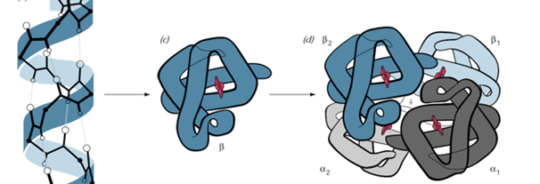
Domain Knowledge
Protein Structure
Secondary to Tertiary to Quaternary
Notes:
molecule forms a spiral which leads to secondary structures
which then folds into tertiary structure – what we’re interested in
which may join with other protein molecules into a final, (in this case) globular protein.

Slide 10
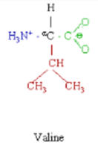
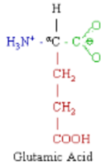
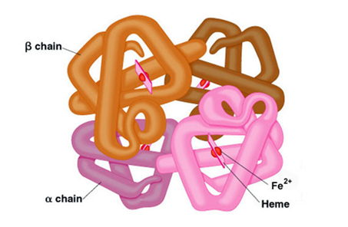
Domain Knowledge
Real World Relevance
Sickle Cell Anemia
Valine substituted for Glutamic Acid
Notes:
Describe polymer formation and side chains

Slide 11

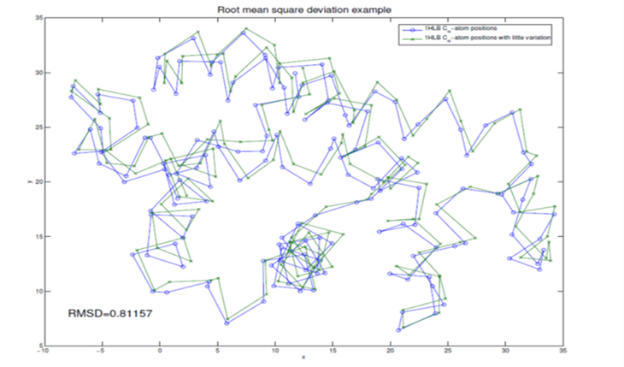
Domain Knowledge
Root Mean Square Deviation (RMSD)
Notes:
delta is distance between corresponding alpha Carbon atoms on superimposed molecules
minimum energy state
Units of length – Angstrom units, 1 x 10 minus 10

Slide 12
Data Set
Physicochemical Properties of Protein Tertiary Structure Data Set
Originally published in CASP 5-9 (Critical Assessment of protein Structure Prediction)
from the Machine Learning Repository, University of California Irvine
No Documentation
“Exposed Area”
Notes:
No Documentation

Slide 13
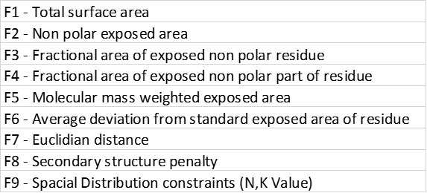
Data Set
Lab Data
Clean and Tidy
Table of Factors
Notes:
Clean and Tidy Data
Remove corrupt or inaccurate data
Hadley Wickham - have a specific structure: each variable is a column, each observation is a row, and each type of observational unit is a table
Seven of the nine factors - area

Slide 14
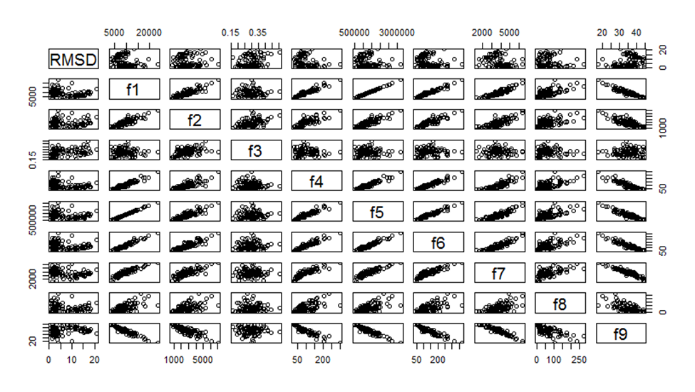
Exploratory Analysis
Lattice Plot : plot(sample2)
Notes:
Plot all two-dimensional combinations
High degree of correlation
f3 “blob” – fractional area of exposed non-polar residue
Note plots of RMSD

Slide 15
Exploratory Analysis
Correlation Coefficients: cor()
 | RMSD | f1 | f2 | f3 | f4 | f5 | f6 | f7 | f8 | f9
RMSD | 1.00 | -0.02 | 0.16 | 0.37 | -0.17 | -0.01 | -0.04 | 0.00 | 0.00 | 0.06
f1 | -0.02 | 1.00 | 0.91 | 0.13 | 0.93 | 1.00 | 0.97 | 0.55 | 0.65 | -0.90
f2 | 0.16 | 0.91 | 1.00 | 0.50 | 0.79 | 0.90 | 0.91 | 0.52 | 0.58 | -0.79
f3 | 0.37 | 0.13 | 0.50 | 1.00 | 0.03 | 0.12 | 0.20 | 0.08 | 0.10 | -0.07
f4 | -0.17 | 0.93 | 0.79 | 0.03 | 1.00 | 0.93 | 0.94 | 0.49 | 0.68 | -0.89
f5 | -0.01 | 1.00 | 0.90 | 0.12 | 0.93 | 1.00 | 0.96 | 0.55 | 0.64 | -0.90
f6 | -0.04 | 0.97 | 0.91 | 0.20 | 0.94 | 0.96 | 1.00 | 0.54 | 0.66 | -0.88
f7 | 0.00 | 0.55 | 0.52 | 0.08 | 0.49 | 0.55 | 0.54 | 1.00 | 0.35 | -0.52
f8 | 0.00 | 0.65 | 0.58 | 0.10 | 0.68 | 0.64 | 0.66 | 0.35 | 1.00 | -0.64
f9 | 0.06 | -0.90 | -0.79 | -0.07 | -0.89 | -0.90 | -0.88 | -0.52 | -0.64 | 1.00
Notes:
cor() function
High degree of correlation between many variable pairs
Absolute values above 0.8
RMSD

Slide 16
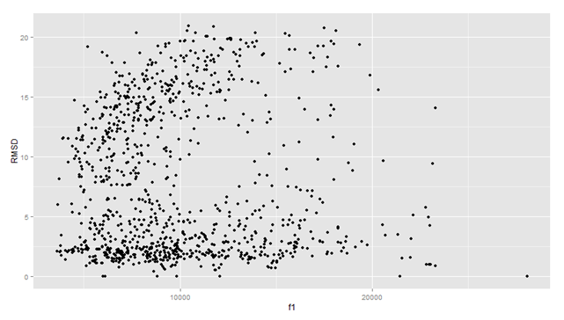
Exploratory Analysis
RMSD vs. Total Surface Area – sample size 1000
Notes:
From lattice plot
RMSD vs several of the variables tends to give “bifurcated” plots
total surface area (f1)

Slide 17
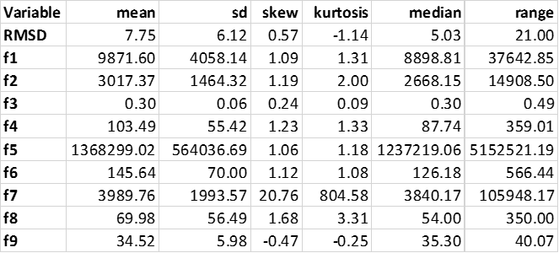
Exploratory Analysis
Descriptive Statistics: describe()
Notes:
Descriptive statistics using the describe() function from the psych package
Keep what we’re interested in using select() function from dplyr
Kurtosis of Euclidian distance (f7)
Other measures OK

Slide 18
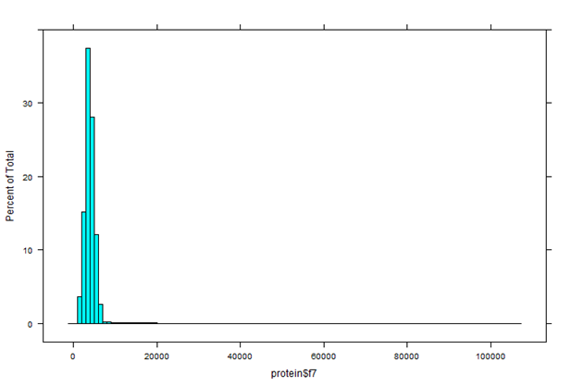
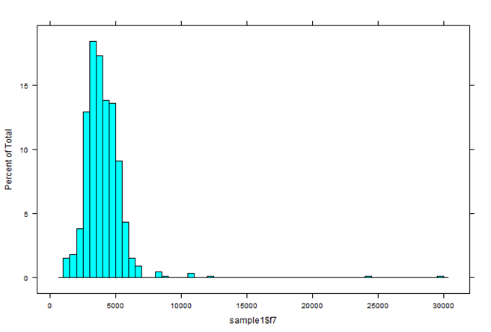
Exploratory Analysis
High Kurtosis for Euclidian Distance (f7)
data set sample size 1000
Notes:
histogram
Outliers in data set 10,000 and 20,000; past 100,000 as well
Sample function, 8,000 to 30,000
Kurtosis is fourth moment, other numbers OK

Slide 19
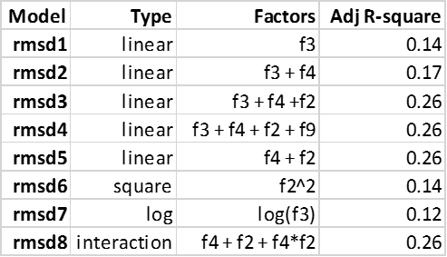
Regression Analysis
Models: lm()
rmsd5: y = 6.90 – 8.76 f4 + 3.28 f2
Notes:
Started with highest correlation with RMSD
Highest R-squared was 0.26
Achieved with four models
Trial and error based on description of variables and domain knowledge
Chosen model was rmsd5 with f2 and f4 - rmsd5 0.26 and fewest factors

Slide 20
Data Set
Lab Data
Clean and Tidy
Table of Factors
Notes:
f2 and f4

Slide 21
Results and Discussion
Exposed non-polar surface area
Highest R-square (0.26) achieved by four models with f2, f3, f4
Chosen model was rmsd5 with f2 and f4
Interaction term added no value
Evaluation of results depends on context
Notes:
Significant factors – exposed non-polar surface area
Other lab data with R-square 0.8 to 0.95 – less than satisfactory
Consider
complexity of protein molecules
five of nine factors – non-polar surface area
Results good
Predict over ¼ of variation from mean of diverse group of very large molecules with very little information
amino acids, sequence, secondary structures – hidden?
Prediction vs. Inference
ISL

Slide 22
Future Work
Investigate how factors were derived
Investigate wwPDB data stores
Search literature for RMSD and other single point predictions
Investigate underlying nature of bifurcation of RMSD plots using classification or cluster methods
Notes:
Predict RMSD plus Inference
Understand physical and chemical forces which caused the differences in RMSD
More investigation into
how factors were derived
wwPDB and its specialized sub-domains
previous work on RMSD and its prediction
Specific domain research – more important in some domains than in others
Other statistical methods, especially the bifurcation of the RMSDs
cluster analysis – statistical measurements within groups – already started
Subset the data then perform regression testing

Slide 23
Exploratory Analysis
RMSD vs. Total Surface Area – sample size 1000
Notes:
RMSD vs several of the variables tends to give “bifurcated” plots
total surface area (f1)
RM
SD = 0; Outliers

Slide 24
Analysis Path
Project
Domain Knowledge
Combinatorial Methods
Protein Structure
Importance
Notes:
Goals clearly defined – predict with a simpler model
Domain knowledge – what to look for, what we’re dealing with

Slide 25
Analysis Path
Data Set
Exploratory Analysis
Lattice Plot
Correlations
RMSD
Descriptive Statistics
Notes:
Exploratory Analysis
lattice plot: correlations, RMSD
Further investigation using descriptive statistics, f7 Euclidian distance
Results: Statistical, Practical
Account for about ¼ of the differences

Slide 26
Analysis Path
Regression Analysis
Results
Statistical
Practical
Future Work

Slide 27

THE END
TITLE
AUTHOR
BIG MOLECULES MEET BIG DATA
predicting protein tertiary structure from combinatorial chemistry data
Stan Siranovich
Principal Analyst
Crucial Connection LLC
Jeffersonville, IN
stan@CrucialConnection.com
www.CrucialConnection.com
This work is the copyright of Stan Siranovich and Crucial Connection LLC

